Slide 1

Location Based Deals and Offers App
Stop waiting. Start saving.

Slide 2

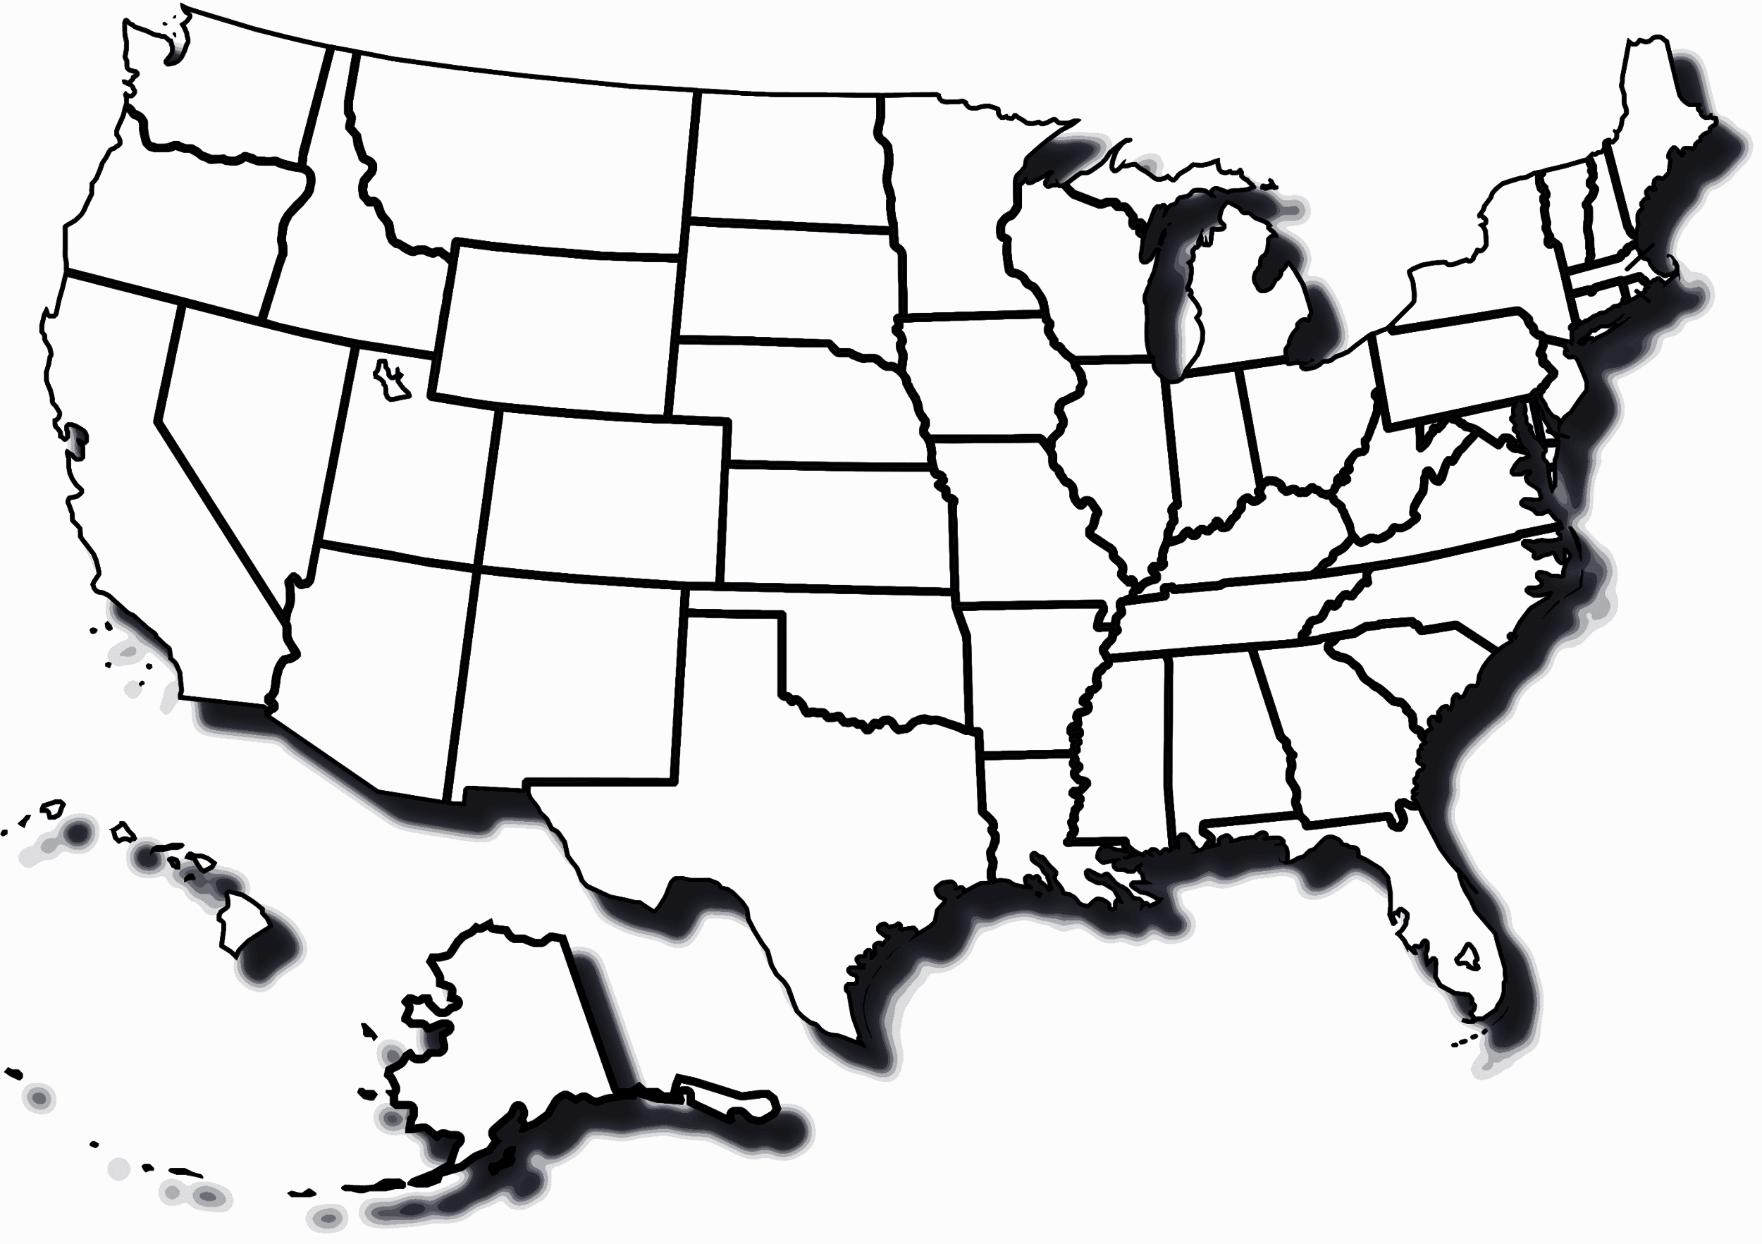
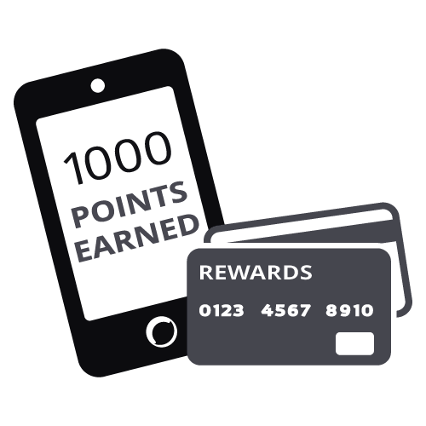

Did You Know?
1095M Credit Cards in the U.S.
On average 3-4 credit cards per user
Reward programs #1 factor in choosing a credit card for > 60% of the users
Users lose out hundreds of dollars in rewards
Notes:
Facts related to credit card and rewards that users avail
Credit card: 200$
And with stores ++

Slide 3
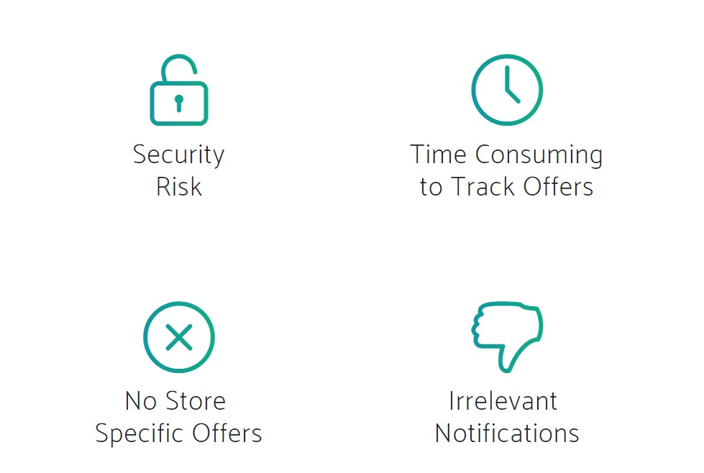
Problem
Notes:
Current solutions problem:
Enter CC number
Offers not at one place

Slide 4
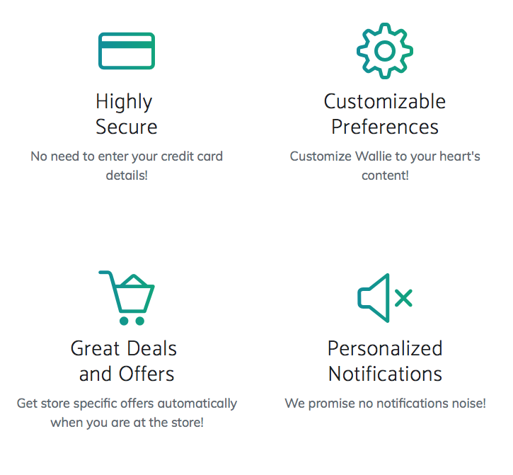

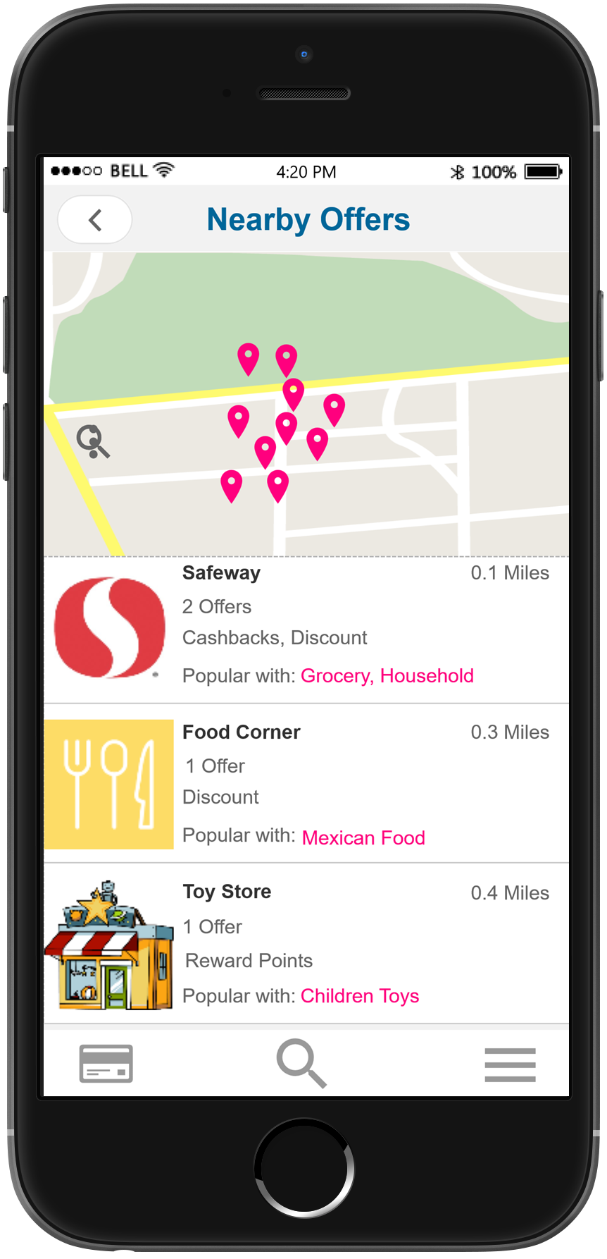
Meet Wallie
Notes:
Based on the current location we provide deals
User’s convenience is our top most priority
Value proposition
Maximum benefits annually
Tailored purchase recommendation experience
Safe and Private platform
Free and User-friendly
Manage purchasing habits with better financial awareness

Slide 5
Our Vision - Maximize Rewards
Our Vision
“Our vision is to help people maximize their savings through rewards and offers based on their preferences.”

Slide 6
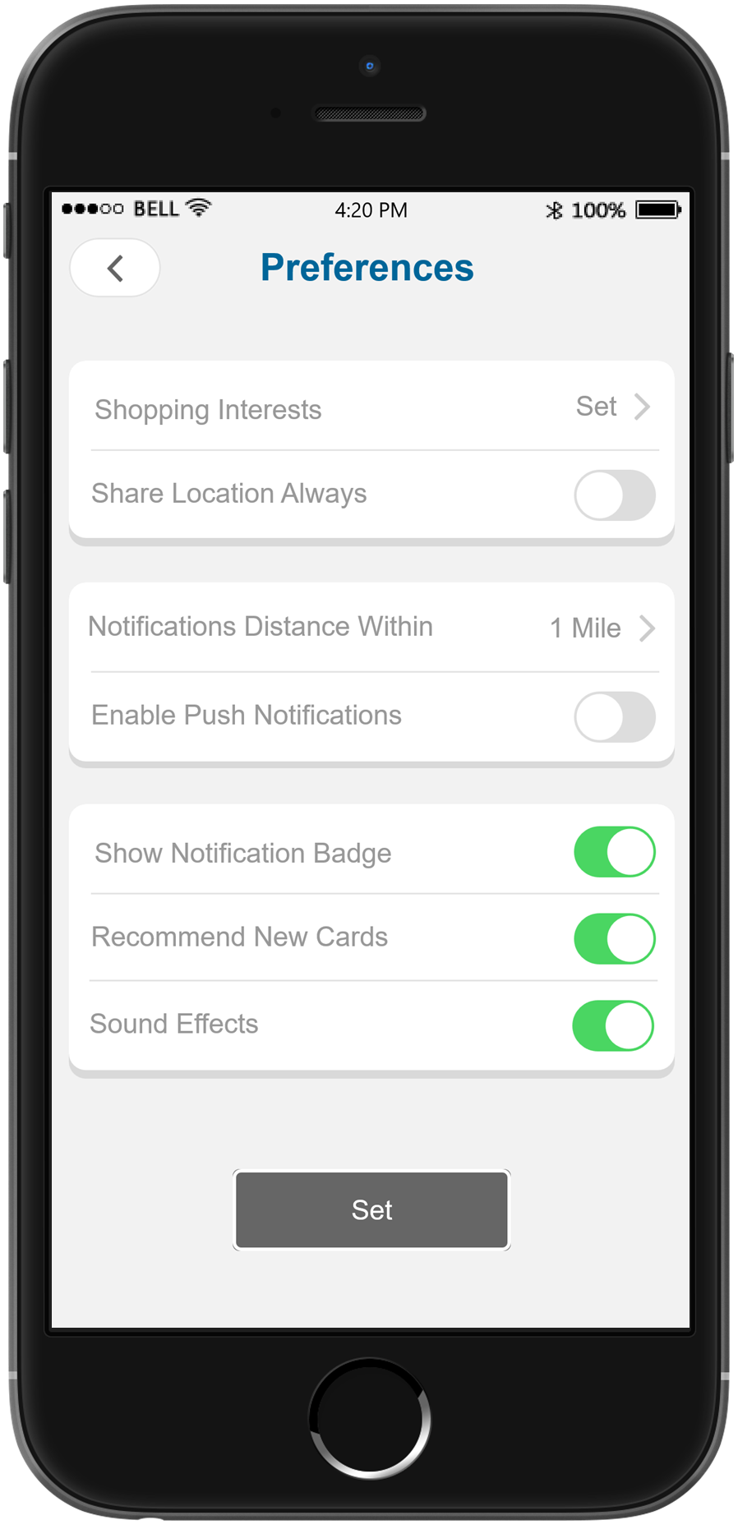
Personalize to Your Heart’s Content
Only get offers that you care about
Store
Credit card

Slide 7
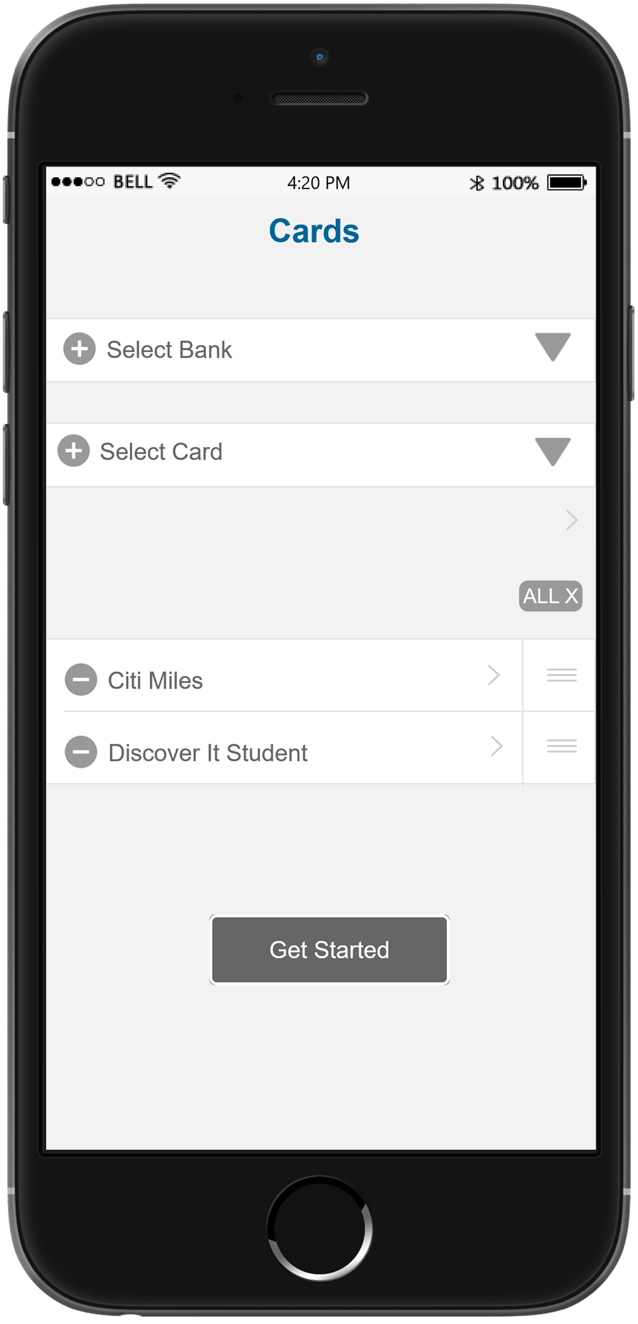
We Don’t Need Users’ Credit Card Numbers
Our Differentiators
We deeply care about our users’ privacy
Wallie delivers value without ever needing users’ credit card details
“I don’t want to share my credit card information with [untrusted] apps because I think it might be a security risk” - Wallie Market Research
Notes:
We do NOT ask for any financial information to get started with the app

Slide 8
Early Users Love Wallie!
Who are our Users?
Based on our estimates, Wallie has helped each of the users save up to $400
“....With a family of four and a job of 9 to 6, I never get the time to go through on-going deals for the credit cards I have. Wallie makes my life easy by providing all the relevant offers based on my preferences at one place place”
- Mrs. Shah, Wallie’s early adopter
“....As a student, I am always looking for ways to save money and Wallie notifies me about store specific offers which maximizes my savings. I will definitely recommend users to install Wallie and start using it as it provides notifications about some great deals”
- Greg Tam, Wallie’s early adopter

Slide 9




Wallie’s Available Here
… and hundreds of other Bay Area stores and restaurants.
Notes:
174 Restaurants
210 Early Adopters

Slide 10
Partners are Excited about Wallie
Who are our Users?
“Wallie helps our restaurant target local customers and drive more business and increase loyalty. It also enables us to plan better and reduce wait times”
- Steve Gates
Owner, Curry in Hurry
“We are constantly looking out for channels to drive more foot traffic and better target our neighborhood customers. Wallie will not only help us with focused advertising but also measure our campaign performance down to every individual in real time”
- Elon Bezos
CEO Easymart

Slide 11






Meet the Team
Krishna
Chief “Everything” Officer
Lan
Chief “Mouthing” Officer
Sanghmitra
Chief “Orderly” Officer
CEO
CMO
COO
Priyanshi
Chief “Big Picture” Officer
Amol
Chief “Tinkering” Officer
CPO
CTO

Slide 12
Investors Trust Wallie’s Vision
$3M Series A funding from BluePoint Ventures and Rocky Ventures
Larry Zuckerberg, Managing Partner at BluePoint Ventures is joining Wallie’s Board of Directors

Slide 13





Get Wallie Today!
Download Wallie TODAY!
getwallie.com
@getwallie

Slide 14
Some Numbers
Download Wallie TODAY!
Total Beta Users | 210
Partners | 174
Average Estimated Savings Per User | Up to $400

